Slide 1
Software Testing Principles and Patterns
Autumn 2024

Slide 2
The goal of unit testing
1- The state of unit testing
Many projects have automated tests; they may even have a lot of them, but the existence of those tests often doesn’t provide the results the developers hope for.
The discussion has shifted from “Should we write unit tests?” to “What does it mean to write good unit tests?” This is where the main confusion still lies.

Slide 3
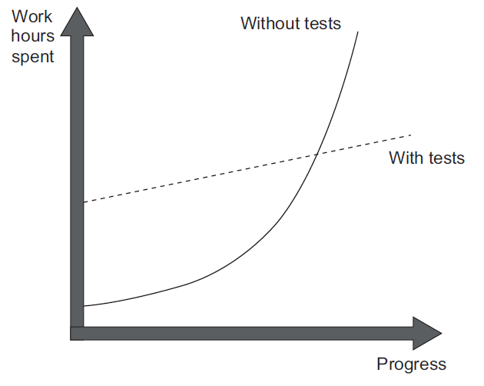
The goal of unit testing
2- The goal of unit testing
Sustainable growth of the software project.
Software entropy:
. Increasingly complex and disorganized
. Fixing one bug introduces more bugs
. Modifying one part of the software breaks several others

Slide 4
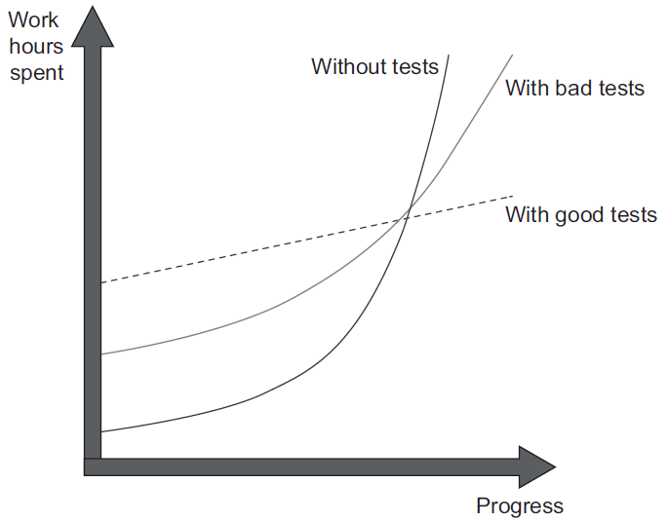
The goal of unit testing
2- The goal of unit testing
What makes a good or bad test?
consider both the test’s value and its upkeep cost.
The cost component is determined by the amount of time spent
on various activities:
. Refactoring the test when you refactor the underlying code
. Running the test on each code change
. Spending time reading the test when you’re trying to
understand how the underlying code behaves

Slide 5
The goal of unit testing
3- Using coverages metrics to measure test suite quality
A coverage metric shows how much source code a test suite executes, from none to 100%.
Coverage metrics are a good negative indicator but a bad positive one.
To read more -> go to page 9, book Unit Testing PP

Slide 6

The goal of unit testing
3- Using coverages metrics to measure test suite quality
Understanding Code Coverage metric
To read more -> go to page 9, book Unit Testing PP

Slide 7

The goal of unit testing
3- Using coverages metrics to measure test suite quality
Understanding Branch Coverage metric
To read more -> go to page 11, book Unit Testing PP

Slide 8
The goal of unit testing
3- Using coverages metrics to measure test suite quality
YOU CAN’T GUARANTEE THAT THE TEST VERIFIES ALL THE POSSIBLE OUTCOMES
To read more -> go to page 12, book Unit Testing PP
NO COVERAGE METRIC CAN TAKE INTO ACCOUNT CODE PATHS IN EXTERNAL LIBRARIES
To read more -> go to page 14, book Unit Testing PP

Slide 9
The goal of unit testing
4- Attributes of a successful test suite
The point is that there’s no automated way to see how good your test suite is.
You have to apply your personal judgment.
A successful test suite has the following properties:
It’s integrated into the development cycle.
It targets only the most important parts of your code base.
It provides maximum value with minimum maintenance costs.

Slide 10


What is a unit test?
1- The definition of unit test
A unit test is an automated test that:
Verifies a small piece of code (also known as a unit)
Does it quickly
And does it in an isolated manner

Slide 11
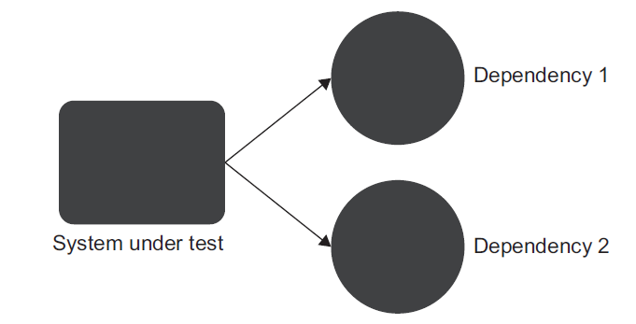
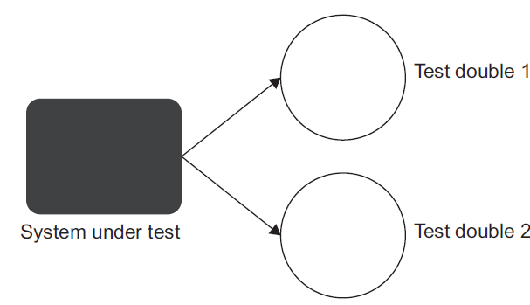

What is a unit test?
1- The definition of unit test
The Isolation issue: The London take
To read more -> go to page 24, book Unit Testing PP

Slide 12
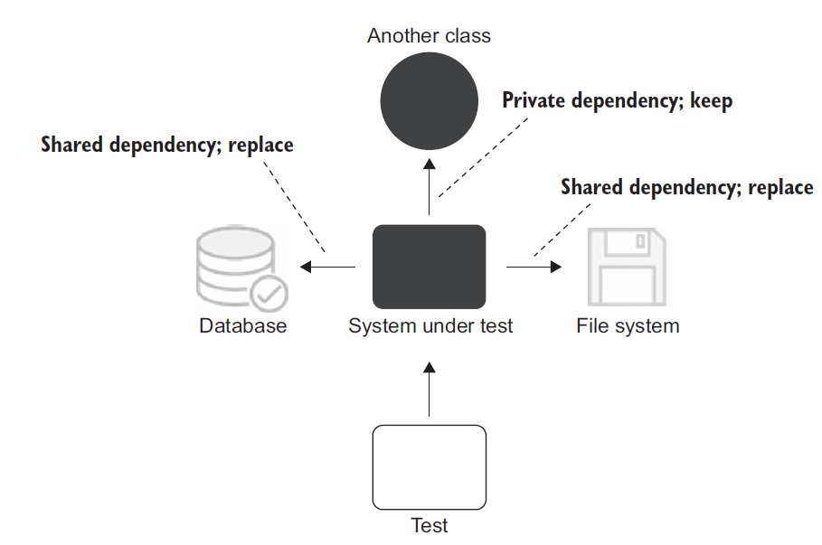
What is a unit test?
1- The definition of unit test
The Isolation issue: The classical take
To read more -> go to page 27, book Unit Testing PP

Slide 13
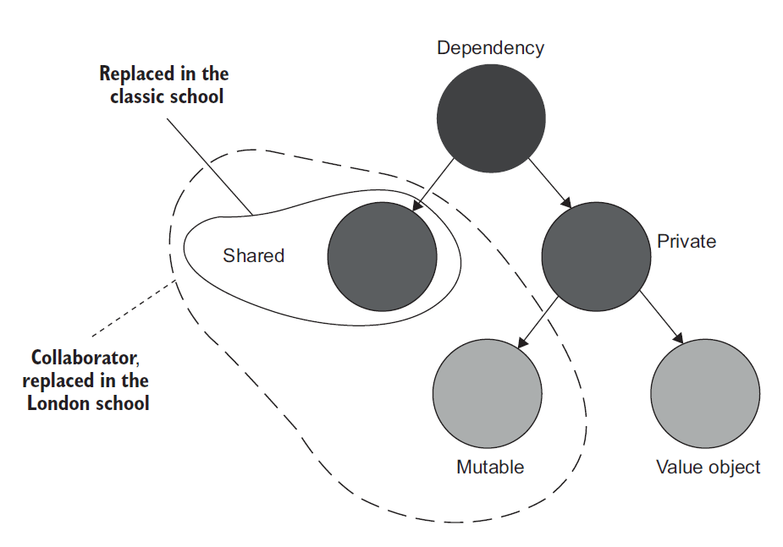
What is a unit test?
2- The classical and London schools of unit testing

Slide 14
What is a unit test?
2- The classical and London schools of unit testing
Collaborator vs. Dependency
customer.Purchase(store, Product.Shampoo, 5)
Here we have three dependencies. One of them (store) is a collaborator, and the other two (Product.Shampoo, 5) are not.

Slide 15
What is a unit test?
3- Contrasting the classical and London schools of unit testing
- Unit testing one class at a time
Observable behavior vs. Internal implementation details
- Unit testing a large graph of interconnected classes
A large class graph is a result of a code design problem
- Revealing the precise bug location
There’s some value in failures cascading all over the test suite

Slide 16
What is a unit test?
3- Contrasting the classical and London schools of unit testing
- Outside-in vs Inside-out
- Over-specification Issue
To read more -> go to page 37, book Unit Testing PP

Slide 17
What is a unit test?
4- Integration tests in the two schools
An integration test is a test that verifies that your code works in integration with shared dependencies, out-of-process dependencies, or code developed by other team in the organization.
Hence the name end-to-end, which means the test verifies the system from the end user’s point of view, including all the external applications this system integrates with.

Slide 18
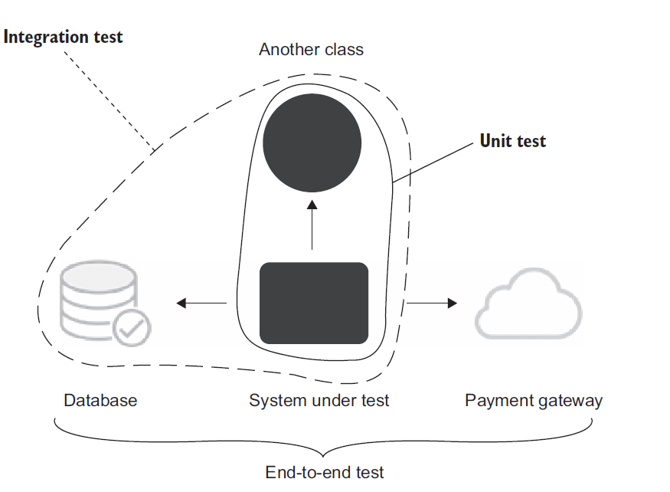
What is a unit test?
4- Integration tests in the two schools

